Slide 1
Agile approach to the software development lifecycle
By: alexis mcvey

Slide 2

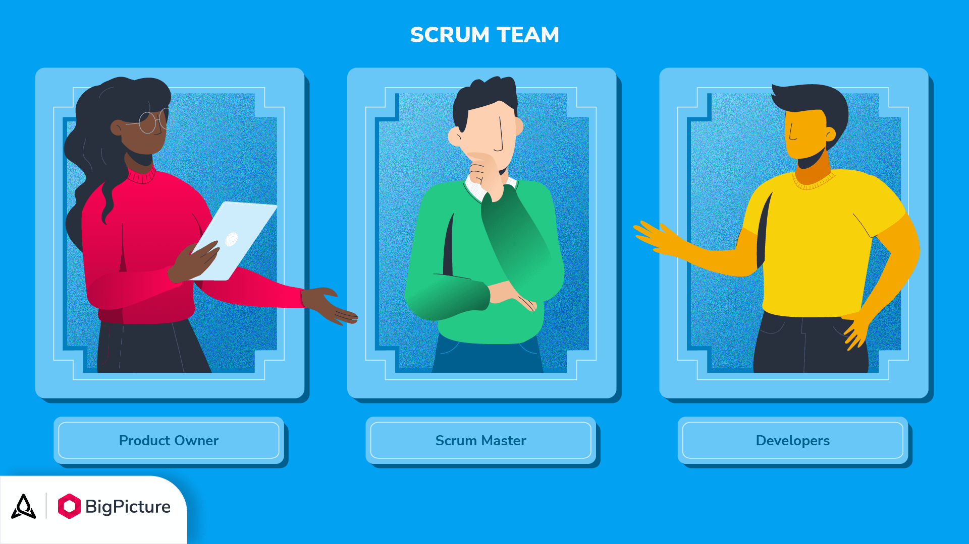
Scrum roles
Product Owner
Set the vision of the product, manages the backlog, communicates the needs of stakeholders to team members.
Scrum Master
Facilitates daily scrum meetings, leads sprint planning meetings, manages obstacles and communicates with team and product owner.
Developer/Testers
Complete scrum sprint tasks, creates user stories, test cases, develops and test codes, conducts bug fixes and feature updates.

Slide 3
Sdlc phases in agile
Concept – ideas are developed, brainstorming sessions happen and Product Owner’s vision is established.
Inception – groundwork for project is set, team roles are determined and tools and technology is chosen.
Iteration/Construction – development takes place. Features are implemented in sprints. Code is written, tested, and revised.
Release – Beta testing takes places. End user and client training takes place. This is considered the “polishing” stage.
Production – Product is released and user feedback and performance metrics are tracked. Updates are made to enhance functionality and bug fixes.
Retirement – Software version is phased out and transitioned to newer technology.

Slide 4
Waterfall approach to sdlc
Requirements – Resource requirements are established
Design – Schedules and milestones are made
Implementation – Data and research collection. Code is written.
Verification – Test cases are made and code is tested.
Maintenance – Bug fixes and feature updates.
Main takeaway
Waterfall doesn't address adaptability to change in stakeholder’s vision and features. Doesn’t encourage and respond to feedback before release of software. Bug and feature fixtures don’t happen until project completion.

Slide 5
Waterfall vs agile
Waterfall
Pros
Clear project structure
Easy to replicate process
No delays dues to additional requirements
Cons
Longer delivery times
Limited flexibility
Limited opportunity for client feedback.
Agile
Pros
Team collaboration
Faster delivery times
Flexibility and adaptability to change
Cons
Poor resource planning
Scaling agile
Team Dependency

Slide 6
References
Scrum roles – the full breakdown - BigPicture. (2023, March 2). BigPicture. https://bigpicture.one/blog/scrum-roles-breakdown/
GeeksforGeeks. (2024, October 18). Waterfall Model Software Engineering. GeeksforGeeks. https://www.geeksforgeeks.org/waterfall-model/
Scrum Guide | Scrum guides. (n.d.). https://scrumguides.org/scrum-guide.html
Radigan, B. D. (n.d.). Agile vs. waterfall project management | Atlassian. Atlassian. https://www.atlassian.com/agile/project-management/project-management-intro

